Slide 1
Measurements for success
Building a community around Juju

Slide 2


Charles Butler
@lazypower

Slide 3
Juju is a Devops Ecosystem

Slide 4
We're starting to form our picture around our community

Slide 5
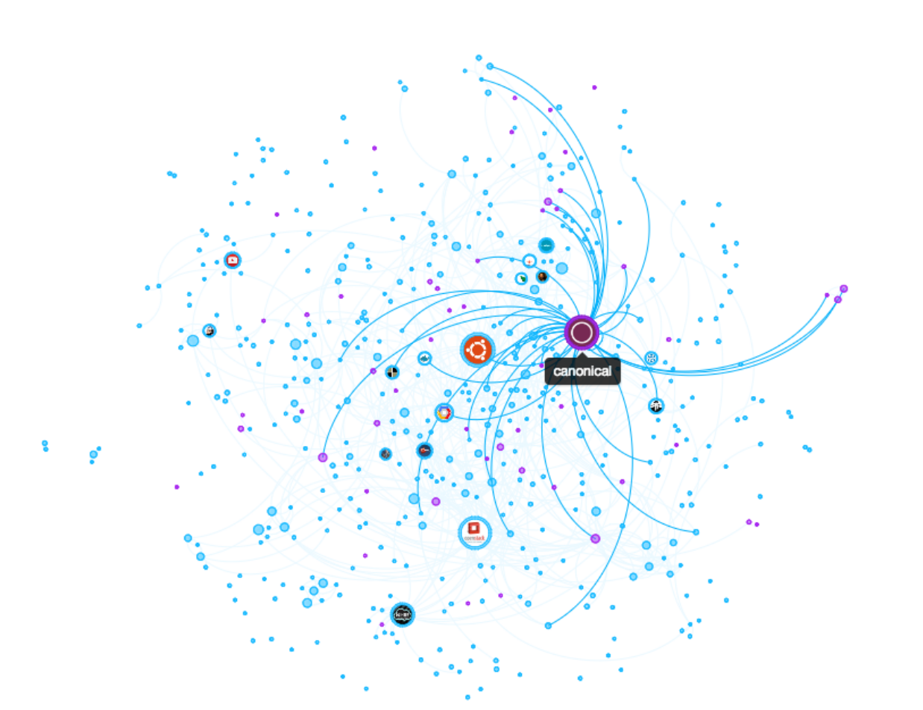
Social Engagements?
Notes:
The graph shows the @ubuntucloud community from early October 2014 to today (26 January 2015).
Again, we can see, by definition, that this is a tight crowd where most of the conversations are interconnected to a primary core.
All of the purple dots are those who discussed Juju during the timeframe in question.
The lines show who ‘communicates’ with Canonical through Retweets, likes, follows, or other interactions.

Slide 6
First Level Metrics

Slide 7

Downloads
Number of commits – Reviewed / Open
Bugs Filed / Triaged / Opened / Closed

Slide 8
Missing Metrics
Emails to the mailing list
IRC Engagements

Slide 9

Identifying Improvement
Easy to slime
provide an incomplete picture

Slide 10
Second Level Metrics

Slide 11
Combine first level metrics
Activity by TimeZone
Contributors by sub-project
Repeat commits vs drive-by commits
Sentiment Analysis to rank positive/negative engagements

Slide 12
Tooling used thus far

Slide 13
iPython Notebook
R
NodeXL
D3.JS
Metrics Grimoire
Data Science Toolkit
Apache Storm & Apache Spark

Slide 14
Charles Butler
@lazypower

